Slide 1
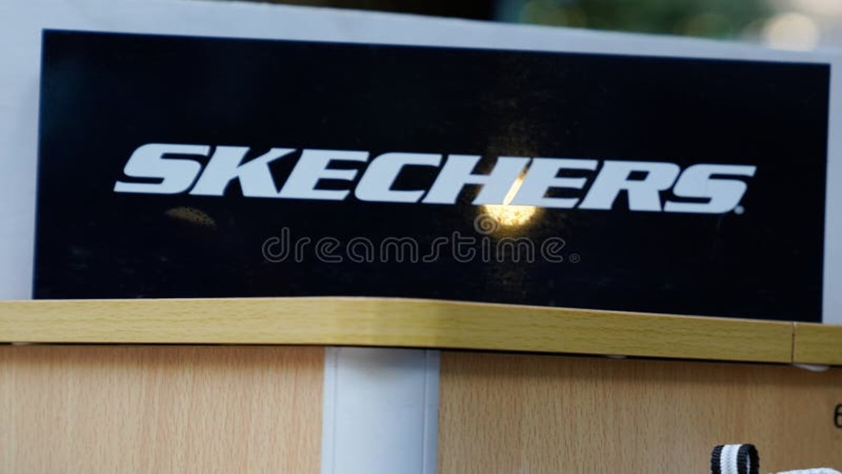
Presented By :
Piyush
Sajit
Umang
Mohd Zaid
Krish

Slide 2
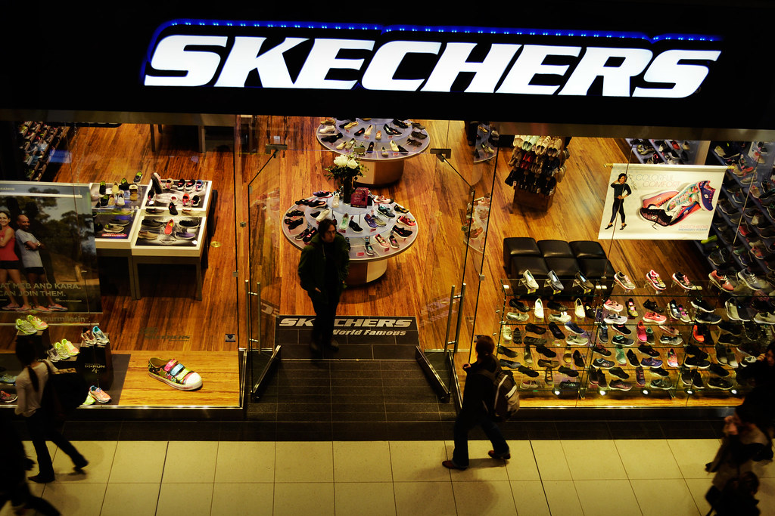
Introduction to Skechers' Information Systems
Skechers, a global footwear company, utilizes sophisticated information systems to manage its operations, enhance customer experience, and drive business growth. These systems are crucial for efficient inventory management, supply chain optimization, and personalized marketing initiatives.

Slide 3

Genesis(ERP)
Inventory Management
1.Real-Time Tracking
Up-to-date visibility of stock across locations
Minimizes stockouts and overstock
2.Demand Forecasting
Analyzes sales data for future demand predictions
Reduces risk of excess inventory
Financial Reporting
Budgeting and Forecasting
Manages budgets and forecasts future performance
Compares actual results with budgeted figures
Auditing and Accountability
Detailed transaction tracking
Enhances transparency and auditing processes

Slide 4
Price of Software Ginesys ERP
Pricing Model: Ginesys typically offers a subscription-based pricing model or a one-time license fee. The cost can depend on the number of users, the modules selected, and the deployment option (cloud or on-premises).
Estimated Cost: Exact figures can vary, but Ginesys is known for catering to mid-sized and large retail businesses. Basic packages might start around $10,000-$20,000 annually for smaller deployments and can go up significantly for larger, more complex installations.

Slide 5
Price of Software Oracle ERP
•Pricing Model: Oracle ERP Cloud is usually priced on a subscription basis, with costs determined by the number of users and the specific functionalities needed. Oracle also offers various deployment options including cloud, on-premises, and hybrid.
•Estimated Cost: Pricing for Oracle ERP Cloud can start from around $50,000 annually for small to mid-sized organizations and can scale up to hundreds of thousands or more for large enterprises with extensive needs.

Slide 6



Competitor software usage
They use Aurical software which work in :-
.Student Management
Track student enrollment, attendance, grades, and financial aid.
.Course Scheduling & Registration
Manage course offerings, schedule classes, and facilitate online registration.
.Faculty & Staff Tools
Provide faculty with tools for grading, communication, and resource management.
They use Aurical software which work for :-
.Inventory Management
Track stock levels, automate replenishment, and optimize inventory allocation across stores.
.Billing and Invoicing: Streamlining financial transactions and invoicing processes.
.Reservation Management: If used in hospitality, it can manage bookings and customer relationships.
THEY USE -: Genesis which is work in :-
.Inventory Management
Supply chain operations
. Finance
.customer relationship management
The price is decided by the corporate
Issued Faced by them :- Lack of employees, sometimes stocks out

Slide 7

Challenges Faced by Skechers Employees
Software Usability and Training Issues
Usability Problems
Lack of Training
Software can be clunky and difficult to navigate, which makes it time-consuming and frustrating for employees to complete their tasks.
Employees often receive inadequate training on new software, leaving them feeling lost and unprepared. This leads to mistakes and delays in daily operations.

Slide 8


Inventory Management Challenges
Stock Outs
Frequent stock outs can occur due to inaccurate inventory tracking, leading to customer dissatisfaction and lost sales. This can also be exacerbated by delays in receiving shipments.
Understaffing
A shortage of employees can further compound inventory management issues. Insufficient staff to manage stock levels can contribute to errors and missed deadlines.

Slide 9
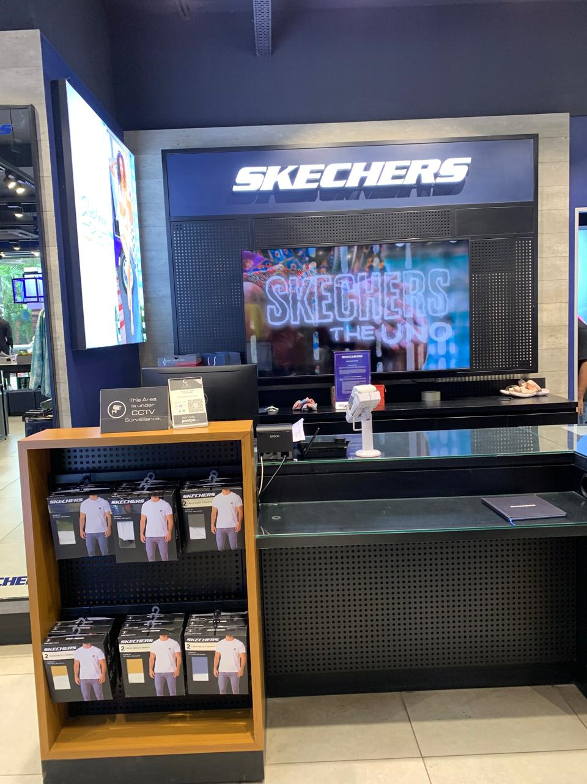
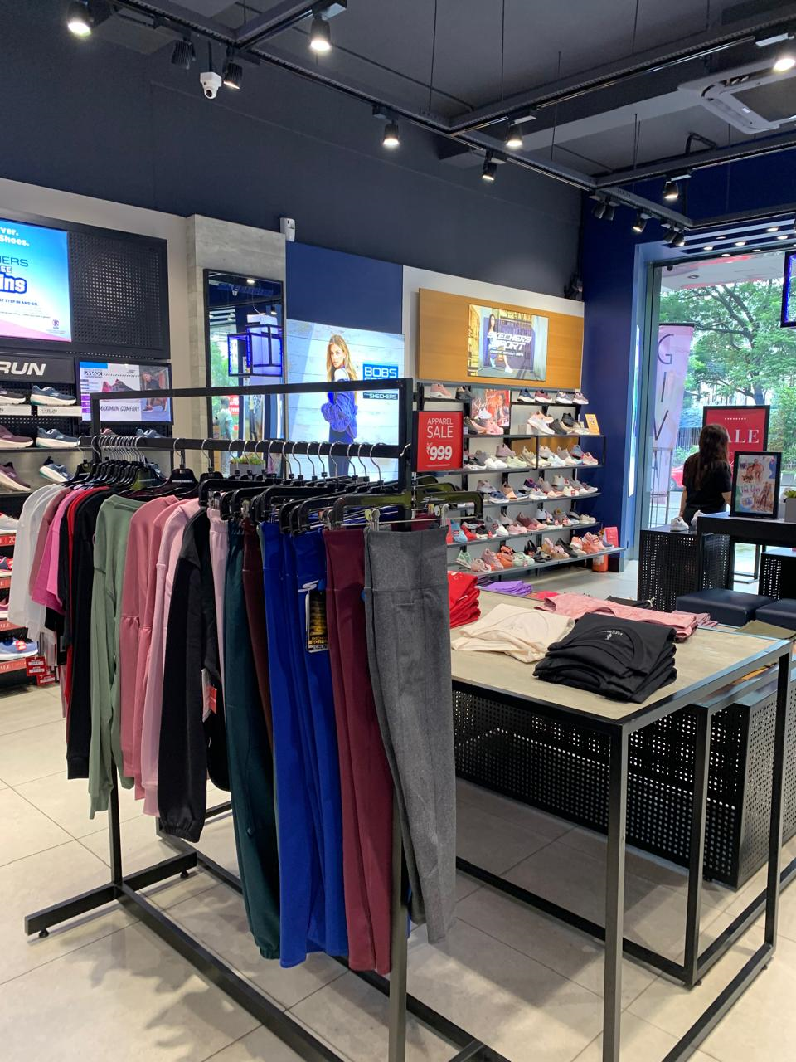
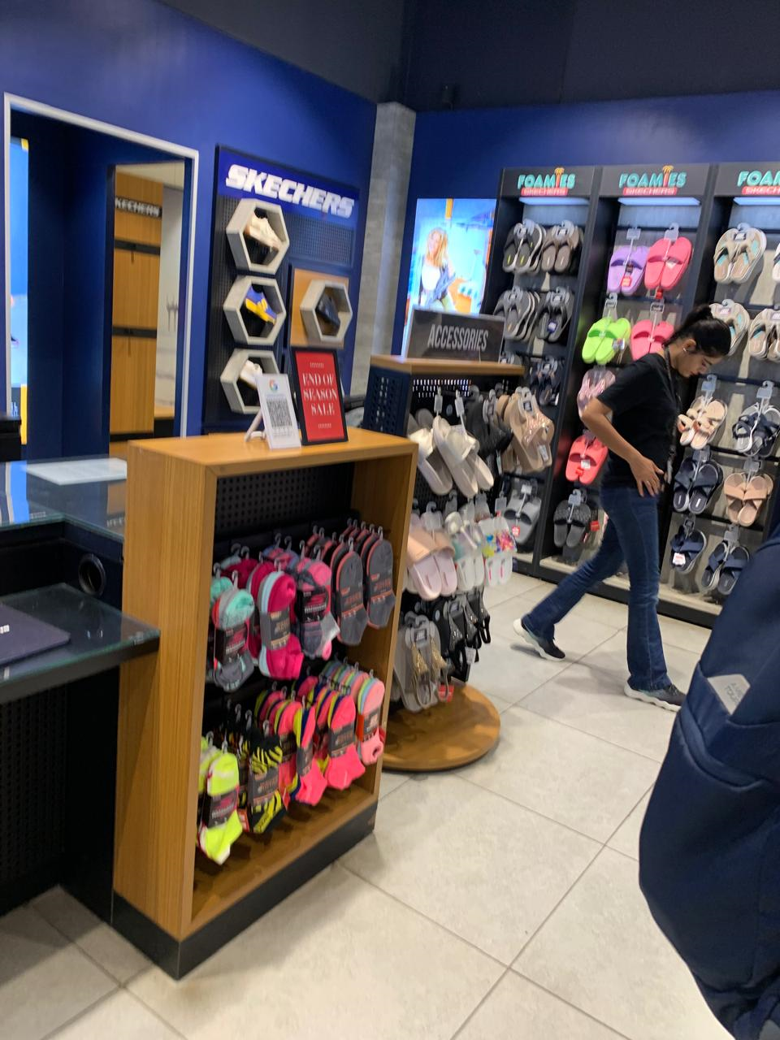
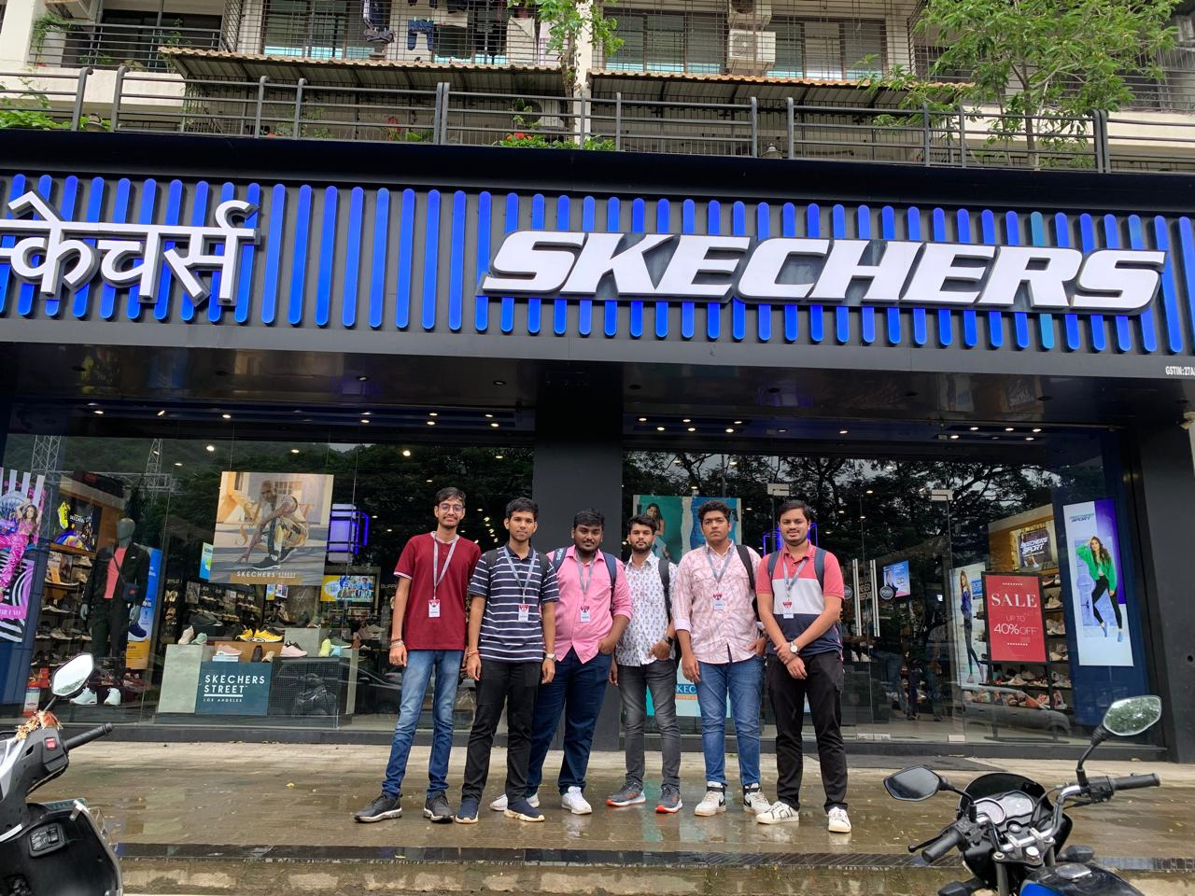

Slide 10


THANK YOU

